Slide 1






HackOrbit 2025
Tensor Titans

Slide 2


Theme: Democratizing Frontline Healthcare Guidance Using AI & ML
Early diagnosis of diseases like Parkinson’s, diabetes, cancer, etc., is critical but often delayed due to a lack of awareness, access to healthcare, and medical expertise in remote areas.
❗1 in 4 people globally lack access to essential health services.
⏳ Delay in diagnosis = reduced survival rates.
🧑‍⚕ Doctor-patient ratio is still low in many countries.
🧑‍⚕Mild symptoms (fever, rash, headache) trigger worry or unnecessary ER visits
⏳Clinics & telehealth backlogs drive long waits and higher costs

Slide 3

MediGuide: An AI-powered web platform for multi-disease prediction and future diagnostic assistance
✅ Input basic symptoms or structured medical data
🧠 Predicts 1,000+ common diseases using ML
🩺 Specialized modules for Parkinson’s, liver, lung cancer, heart disease, and diabetes
🔍 Multimodal analysis: ClinicalBERT symptom→condition ranking X-ray, skin-lesion, ECG & retinal image analyzers
💬 Natural Chat & Voice interface powered by Gemini + Whisper
💡 Fact-Checked Guidance via RAG over Mayo Clinic/WebMD
📈 Continuously expanding knowledge base & model library
💊 Future-Ready Roadmap: prescription suggestions, in-app chatbot follow-up, telehealth escalation, analytics dashboard

Slide 4
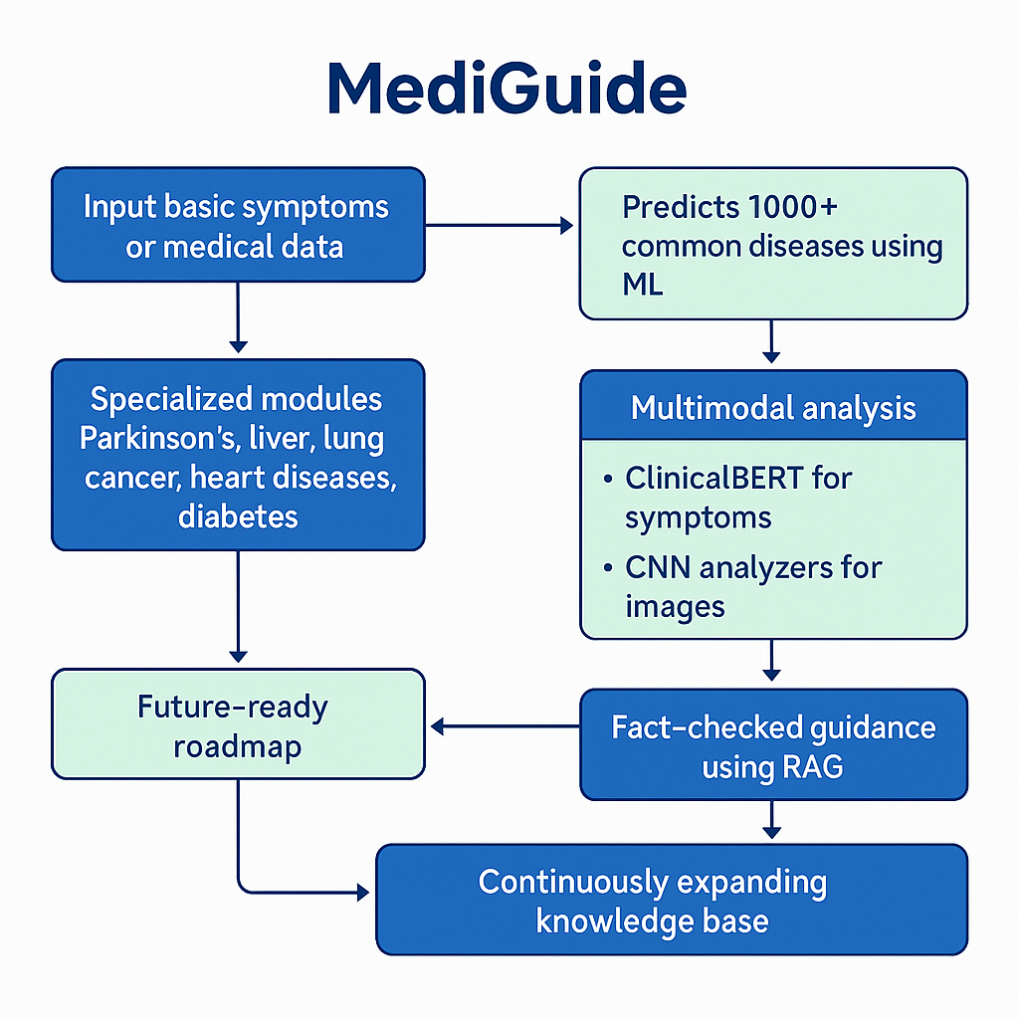
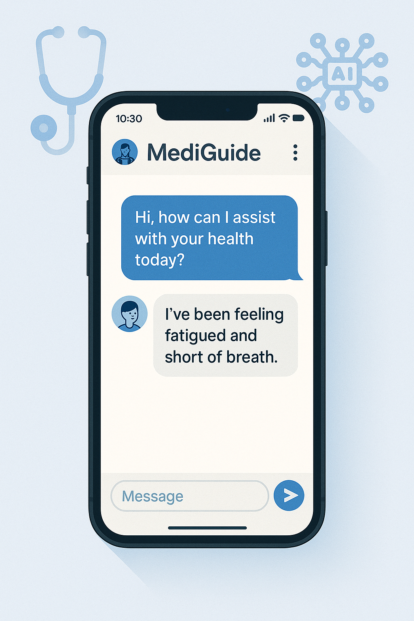
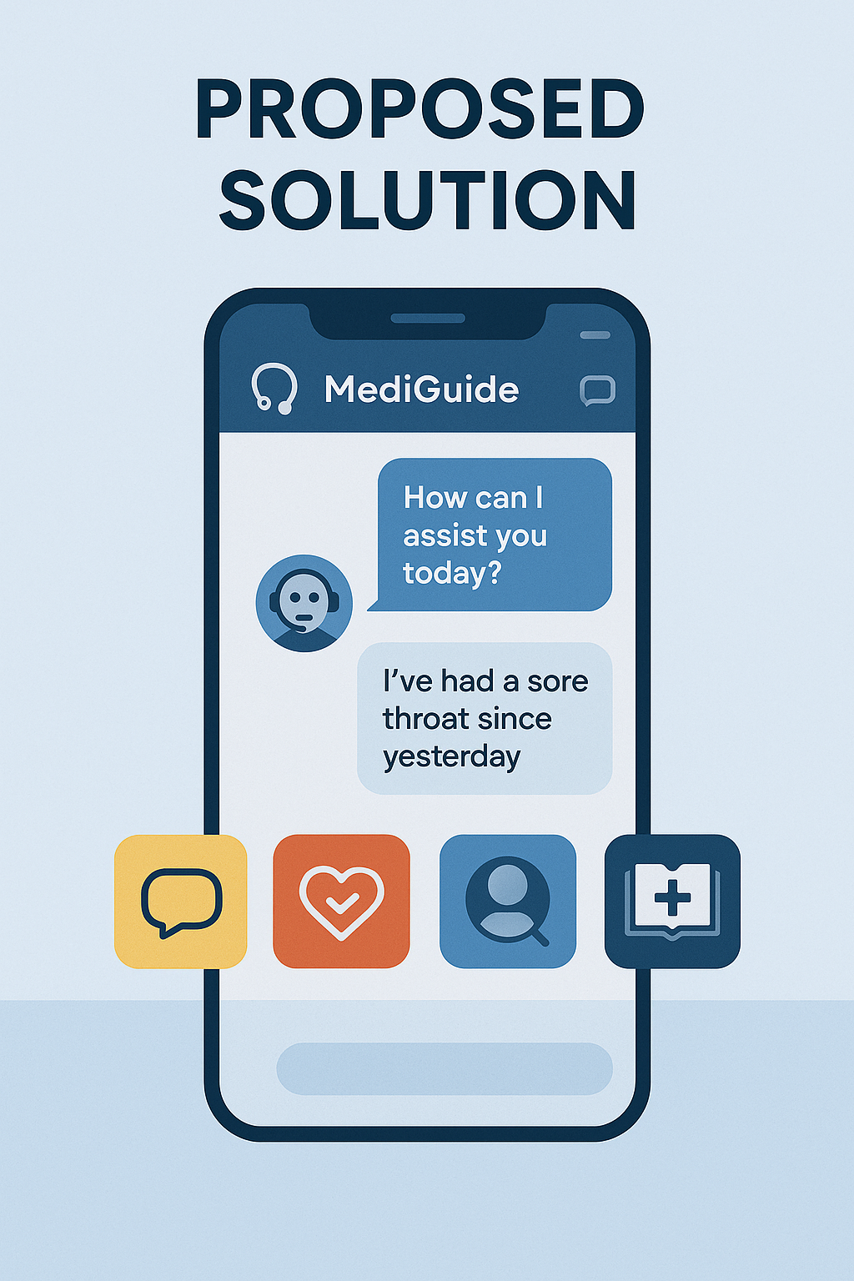
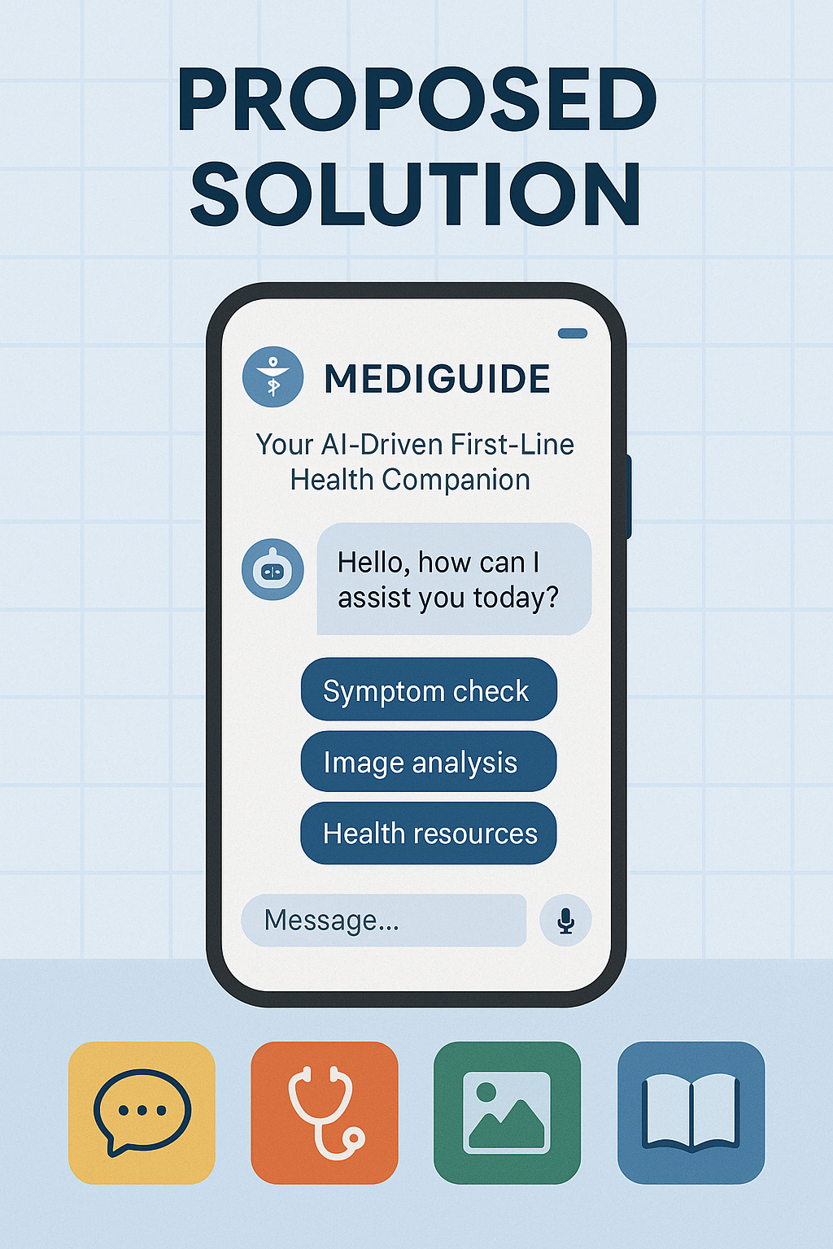

Slide 5
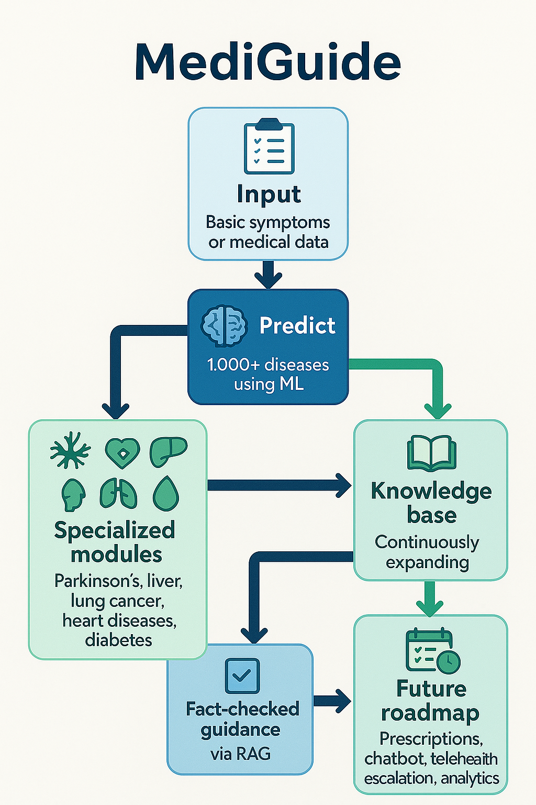
Input (Basic Symptoms or Medical Data)
Users enter free-text symptoms or structured measurements (e.g. vital signs, lab results).
Predict (1,000+ Diseases via ML)
A core ML engine (e.g. ClinicalBERT + gradient-boosted trees) generates a ranked list of likely conditions.
Specialized Modules
For high-impact categories (Parkinson’s, liver disorders, lung cancer, heart disease, diabetes), dedicated CNN or time-series models deliver deeper, domain-specific predictions.
Knowledge Base (Continuously Expanding)
A retrieval index of peer-reviewed articles (Mayo Clinic, WebMD) is kept up to date with new guidelines and studies.
Fact-Checked Guidance (via RAG)
The system augments model outputs with context-aware excerpts and citations from the knowledge base, ensuring recommendations are accurate and transparent.
Future Roadmap
Prescription suggestions, in-app chatbot follow-ups, voice assistant integration, telehealth escalations, and analytics dashboards link back into the knowledge base for ongoing learning and feature evolution.

Slide 6
Features
Universal Input: Accepts free-text symptoms, voice dictation (Whisper ASR), structured vitals/labs, or medical images
1,000+ Disease Predictions: Single-pass ML engine ranks likely conditions
Specialized Diagnostics: CNN/LSTM modules for Parkinson’s, liver & lung imaging, ECG arrhythmias, and diabetes
Empathetic Chat & Voice UI: Gemini-powered dialogue with natural, hands-free follow-up questions
AR-Guided Self-Exam: On-screen overlays ensure properly framed skin and wound captures
Future-Ready Extensions: Prescription suggestions, in-app chatbot follow-ups, telehealth escalation, analytics dashboard
Novelty
Retrieval-Augmented Guidance: RAG layer fuses model outputs with peer-reviewed excerpts (Mayo Clinic, WebMD) and inline citations for maximum trust
Continuous Learning Pipeline: Automated ingestion of new clinical guidelines and consented chat logs drives periodic retraining
Unified Multimodal AI: Seamless integration of text, voice, image, and time-series models in one platform
Transparent Outputs: Clinician-benchmarked metrics and “Visit Report” summaries ensure clarity and shareability

Slide 7

Drawbacks
⚠ Dependence on user-provided data accuracy.
🧪 Limited real-time clinical testing for some models.
🔐 Handling sensitive data securely requires robust infrastructure.
Showstoppers
🛑 Model Misdiagnosis: We display confidence scores and clearly state it’s not a replacement for a doctor.
🔐 Data Privacy: Plan to integrate end-to-end encryption and optional local inference.
📊 Scalability: Cloud-based microservices architecture planned for better performance.

Slide 8
Tensor Titans
HEMANT – 8930721031 – kadianhemant320@gmail.com
Sparsh Patidar – 9829705597- sparsh.patidar2023@vitstudent.ac.in
Aniket Raj – 9279159976 –aniket.raj2023@vitstudent.ac.in
Khwaish Yadav – 8130330085 – khwaish.yadav2023@vitstudent.ac.in

Slide 9
Thank you

